Slide 1
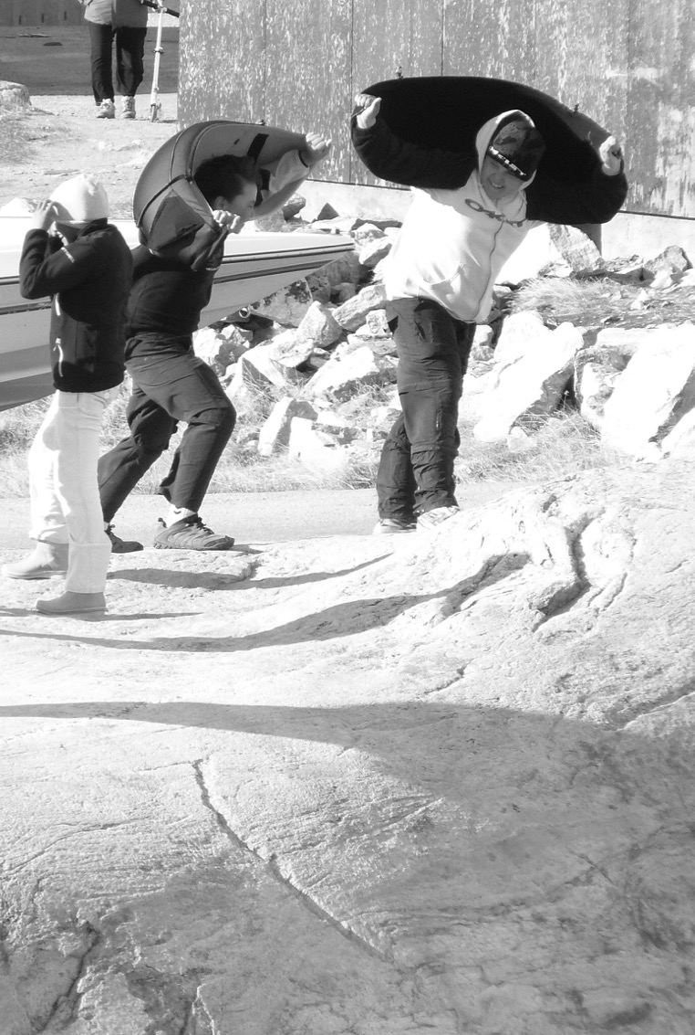
Social planning for homelessness
in Nuuk through
intersectorial collaboration
a rural/arctic case
Steven Arnfjord
Sociolog, ph.d., adjunkt
Institut for Samfund,
Økonomi & Journalistik

Slide 2
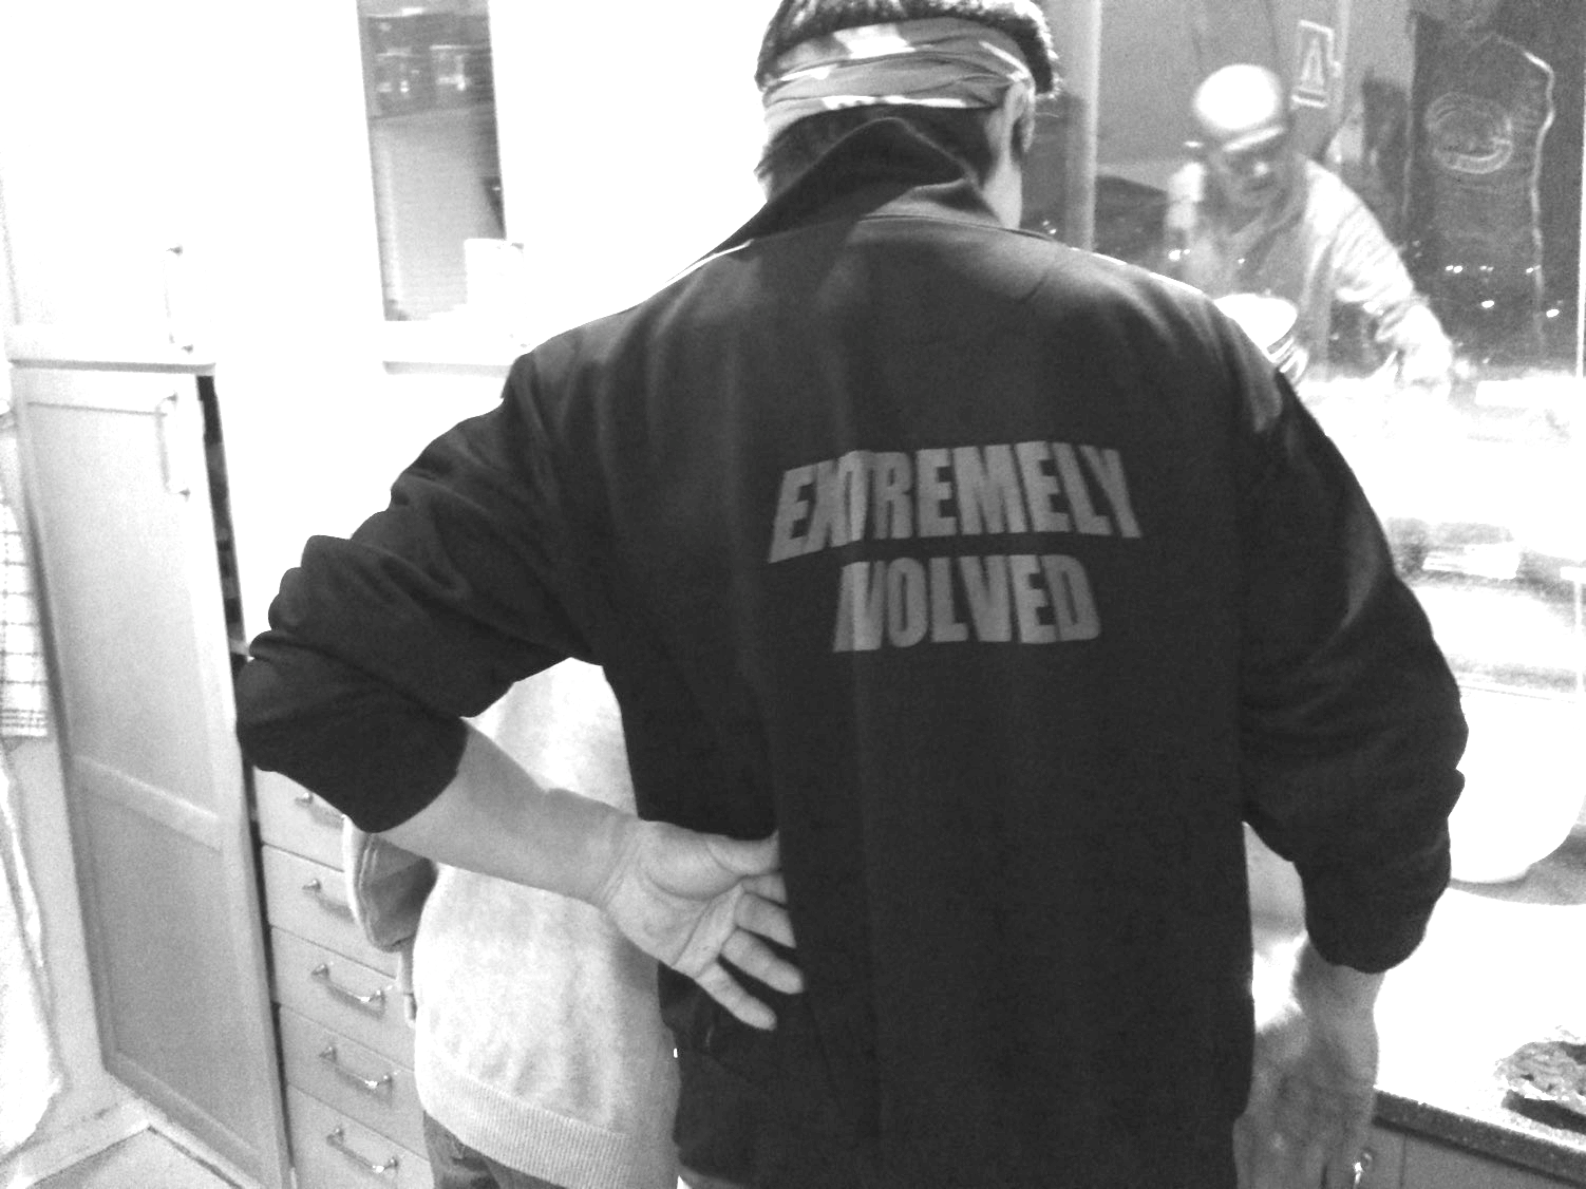
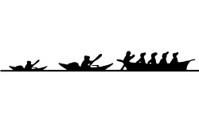
ILISIMATUSARFIK
Institute of Social Science, Economy and Journalism
Dias 2

Slide 3
ILISIMATUSARFIK
Institute of Social Science, Economy and Journalism
Kalaallit Nunaat - Greenland
Total population 56.200
A colony from 1720s to 1953
Still a part of the Danish realm
A political democracy
A universal welfare system – a social democratic regime
(tax paid health care, education and so on)
Dias 3

Slide 4
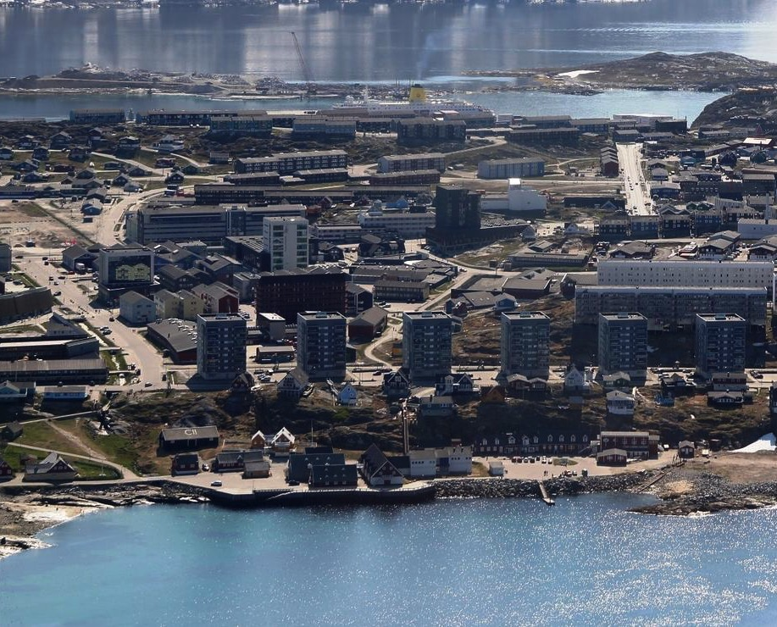
ILISIMATUSARFIK
Institute of Social Science, Economy and Journalism
NUUK
Main capital
Administrative &
educational centre
Population of 16.500
Oldest city in the
country “Founded”
in 1728
Nuuk
Dias 4

Slide 5
ILISIMATUSARFIK
Institute of Social Science, Economy and Journalism
The problem
Homelessness in Nuuk a new and increasing trend:
A Conservative estimate: 100
Local community says: 300
Mean temperature of -1 Celsius
15 times the level of Copenhagen (Source: HusForbi jan. 2016)
1 Municipal shelter that houses 36
Dias 5

Slide 6
ILISIMATUSARFIK
Institute of Social Science, Economy and Journalism
Data gathering
12 months of weekly field contact
Qualitative interviews:
Politicians
Researchers
Nurses, social workers, case workers
NGO staff & leaders
People-on-the-street-talks
Focus groups / round table (forth coming, fall 2016)
Photo voice study (forth coming, fall 2016)
Dias 6

Slide 7
ILISIMATUSARFIK
Institute of Social Science, Economy and Journalism
Big increase in the soup line
SOUP KITCHEN
Spring periods | Total Servings | Average Servings | % Increase
2014 | 488 | 22
2015 | 701 | 27 | 23% (since 2014)
2016 | 881 | 46 | 70 % (since 2015) 109 % (since 2014)
Dias 7

Slide 8
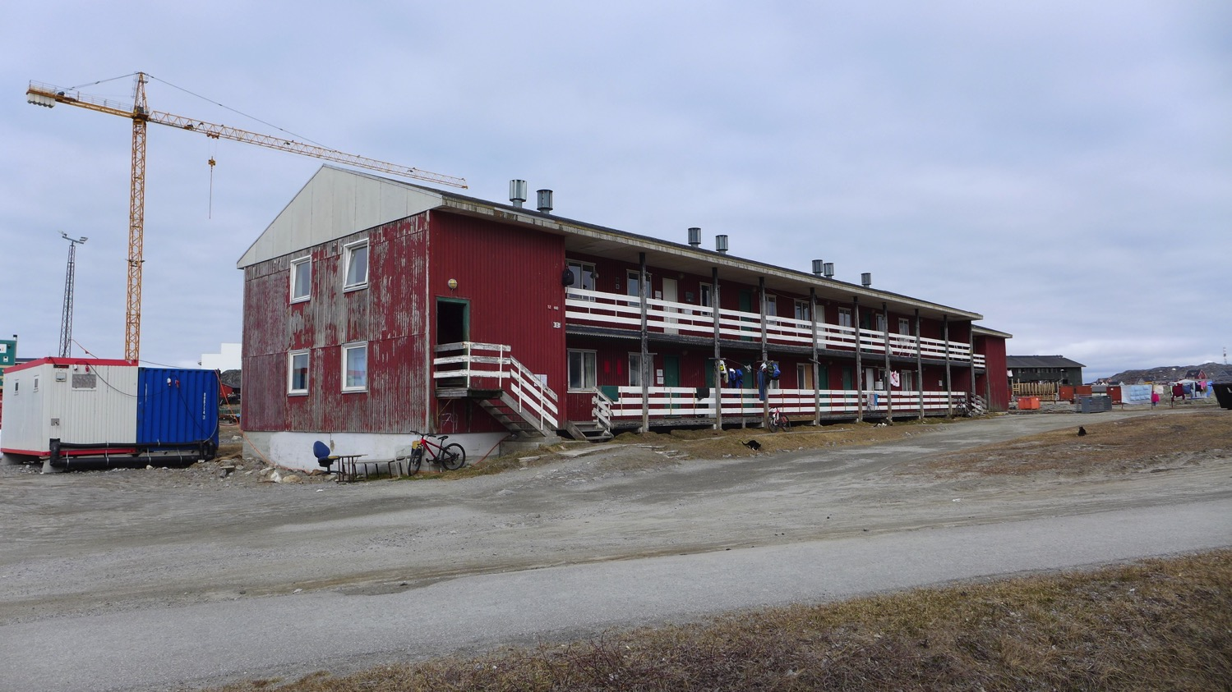
ILISIMATUSARFIK
Institute of Social Science, Economy and Journalism
Dias 8

Slide 9
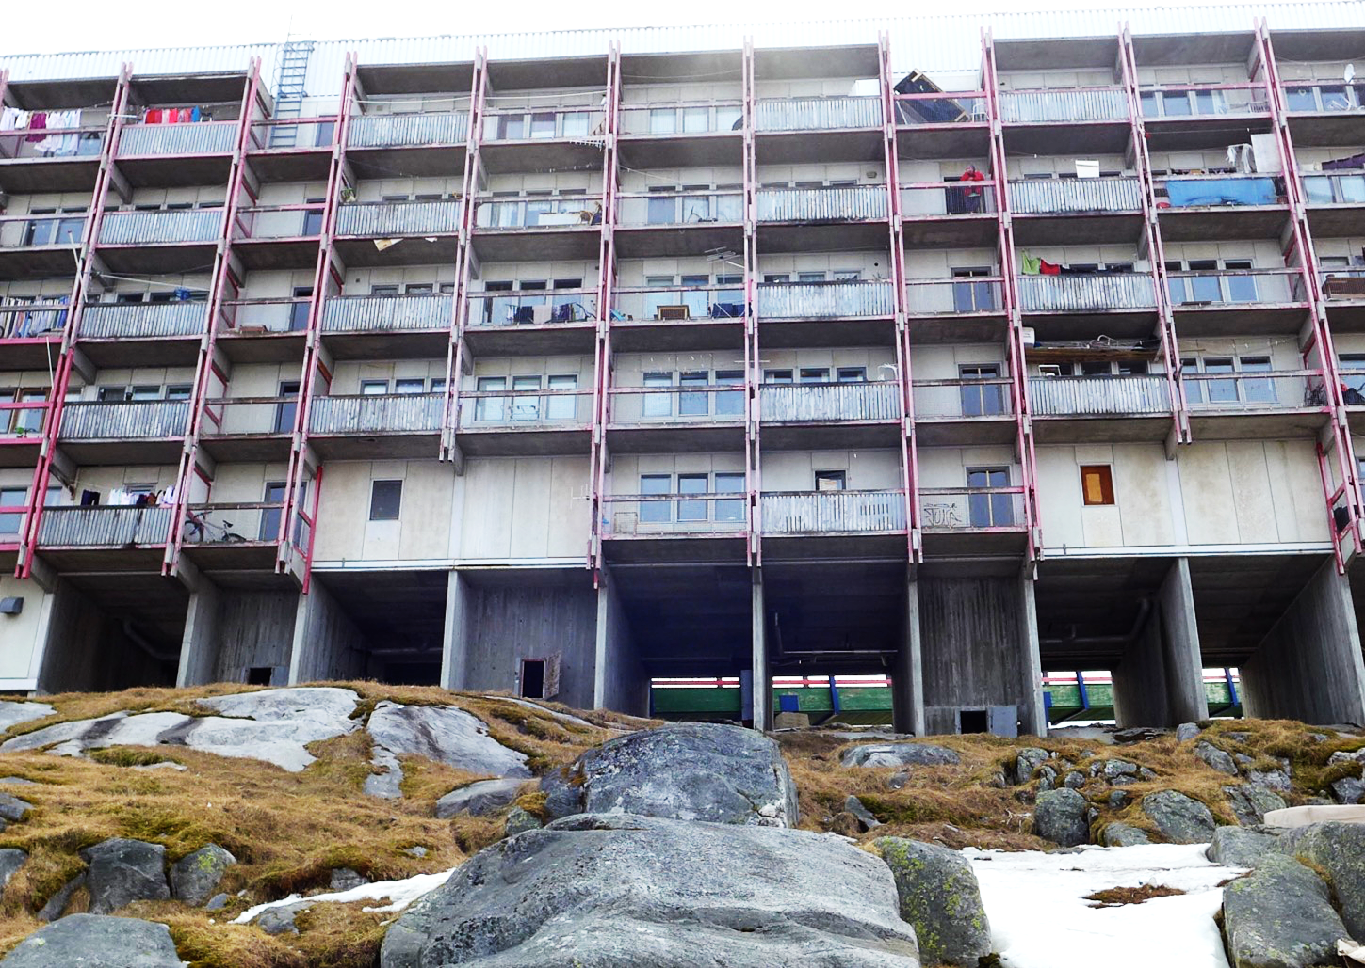
Institute of Social Science, Economy and Journalism

Slide 10
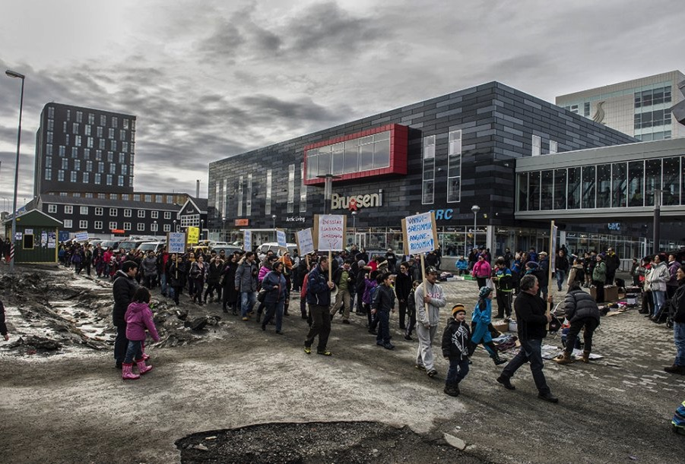
ILISIMATUSARFIK
Institute of Social Science, Economy and Journalism
The problem
100 Conservative estimate
300 from local communities
Mean temperature of -1 Celsius

Slide 11
ILISIMATUSARFIK
Institute of Social Science, Economy and Journalism
Each sector for it self
The health care sector deals exclusively with health related matters. No clear strategies on ground level on how to respond to social matters.
The social sector handles social affairs. Focus is: Children, families, and youths
Private NGO´s handles the rest the “in betweeners”
Dias 11

Slide 12
ILISIMATUSARFIK
Institute of Social Science, Economy and Journalism
A quick case story
Inuk told me:
I went to the doctor with my arm because it hurt and I couldn´t move my shoulder.
The doctor looked at it a few times and said that I needed an operation, but I could not be submitted to an operation because I did not have a permanent address.
They demanded that I could be released to a permanent address so that I could continue with my appointment at the hospital for physical therapy.
Dias 12

Slide 13
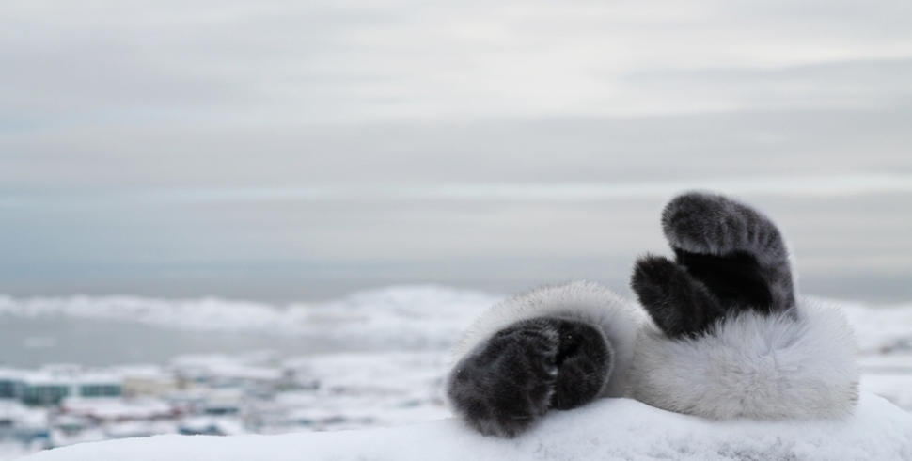
ILISIMATUSARFIK
Institute of Social Science, Economy and Journalism
Funny, I don’t know what you are doing?
Tekst
Don´t worry about it.
I don´t know what you are doing either
Dias 13

Slide 14
ILISIMATUSARFIK
Institute of Social Science, Economy and Journalism
The case of 3 NGOs
Dias 14

Slide 15
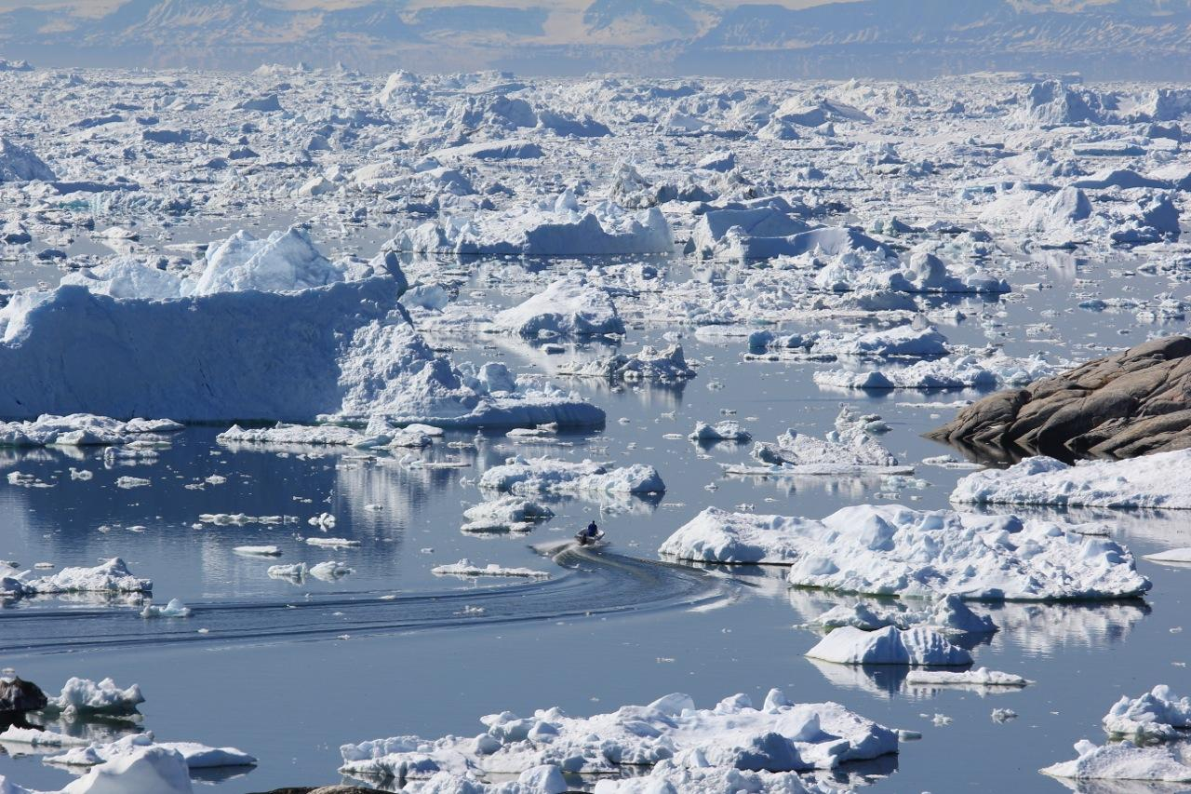
ILISIMATUSARFIK
Institute of Social Science, Economy and Journalism
Dias 15

Slide 16
ILISIMATUSARFIK
Institute of Social Science, Economy and Journalism
Planning for future solutions
Change has to come from below (little political will)
Locate – the disempowered group
Plan – for future collaboration between public sectors
(round tables and campaigns in the fall 2016)
Basic awareness of mandate & obligations to act between sectors
Execute – participatory and democratic solutions that are empowering for people in need (evaluate and document)
Dias 16

Slide 17
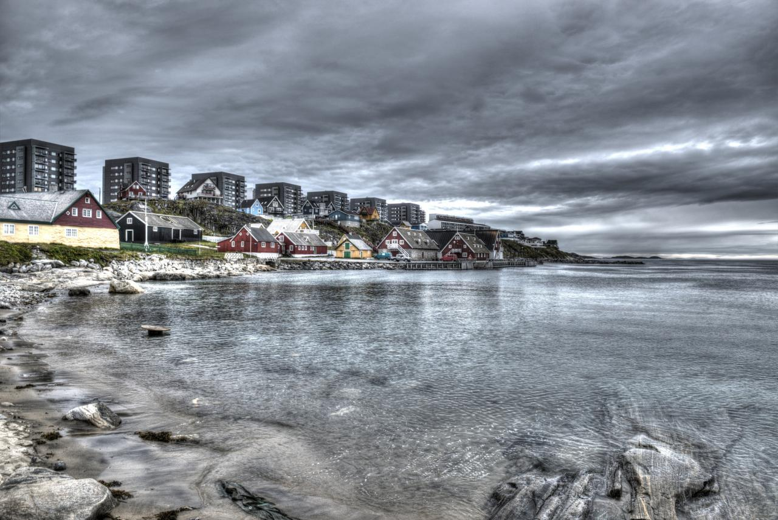
ILISIMATUSARFIK
Institute of Social Science, Economy and Journalism
Qujanaq – Thank You
Qujanaq – Thank you
Please follow the twitter account: @stevenarnfjord – for updates
Email: Star@uni.gl
Dias 17

